Slide 1
LF Energy
Digital Substation - Design Team #1
(61850 model implementation and configuration)
CoMPAS project Roadmap
April, 2020

Slide 2
Context and motivations

Slide 3
Background / Motivation
Due to the Energy Transition the use of power transmission and distribution grids is changing. The control architecture of power grids needs to be swiftly adapted to take account of infeed at lower grid levels, higher dynamics in flow patterns and more distributed controls (both internal controls and grid flexibility services from third parties).
In this context TSOs and DSOs require a new generation of Digital Substation Automation Systems (DSAS) allowing for more dynamic protection settings and adaptative automation functions. Moreover, data management gets significant, both for administration of deployed automation and protection functions as well as operational grid data.
The design of the new DSAS will have to allow for a drastically higher level of modularity, interoperability and scalability compared to the previous generations. An open source collaboration is essential to meet those requirements in a cost-efficient way by sharing the effort through a leveraged development approach that involves all stakeholders from equipment manufacturers to end-users, fostering vendor-agnostic implementations and convergence of utility practices.

Slide 4
Objectives
The aim of the CoMPAS project is to develop open source software components related to IEC 61850 model implementation (profile management) and configuration of a power industry Protection Automation and Control System (PACS).
This open source initiative will:
leverage multi-vendor and multi-end-user development resources and 61850 competences to accelerate the development of common software blocks
promote top-down configuration processes and common model implementation choices (thus also accelerate the conformity to IEC 61850 through software implementation)
The project should not duplicate works already carried out in standardization groups. Instead it should aim at delivering a production grade and reference implementation of the standard. When the rules and principles from the standard are not comprehensive enough or subject to interpretation or still work in progress, the project may have to take choices for the implementation. In such case it should strive to a configurable implementation.

Slide 5
Main use cases
Tools for IEC 61850 profile management and configuration are needed at various business processes of the power grid industry
When planning grid infrastructure in order to facilitate the design of power system adaptations and the engineering of substation PACS to be installed or upgraded
During PACS procurement and delivery phase in order to specify the requirements and perform multi-vendor system integration and commissioning
During the operational live of PACS in order to adapt to changes in operational conditions and to perform system configuration updates
For asset management activities in order to perform maintenance actions and PACS upgrades
Additionally, there is a demand for better availability of Substation PACS data at enterprise level (functions & settings, operational process data) and for enhanced interoperability between processes at substation and enterprise levels:
Improve through higher automation the interlinkage between grid planning and PACS engineering processes
Improve through higher automation the interlinkage between the configuration of PACS and the configuration of central systems (SCADA, asset management)

Slide 6
Functional scope

Slide 7
Core functions for profile management and configuration tools
The main functional blocks required in order to address the needs previously described (and therefore to be included in the roadmap) are:
System configuration: “System Specification Description (SSD)” to “Substation Configuration Description (SCD)” conversion, PACS policy registry (scripts?), API to vendor specific IED configurators
IEC61850 profile management: logical device/function builder, library of common profiles for usual functions, versioning, definition of reusable user profile of IEC 61850 data model (potentially continue/restart ENTSO-E profiling tool)
Conformity verification of System Configuration description Language (SCL) files
System specification: profile to “System Specification Description (SSD)” conversion, PACS policy registry (scripts?), API to vendor specific “IED Capability Description (ICD)” tools, ICD conformity check, ICD compatibility management, ICD versioning / repository
Availability of Substation PACS data at enterprise level (Functions & settings, operational process data)

Slide 8
IEC61850-CIM mapping functions
In order to fulfill the need for enhanced interoperability between processes at substation and enterprise levels, the roadmap of the project should also include the development of mapping functions between CIM and 61850.
New standard IEC 62361-102 provides recommendation to both CIM and IEC 61850 groups to improve both standards’ cross-compatibility
But the standard 62361-102 focuses only on one way: IEC CIM configuration from IEC 61850
The mapping functions to be developed should be automatic, configurable and bidirectional.
CIM and IEC 61850 are both based on XML file for representation of a configuration. Automatic rules could be derived from the standard based on which open source transformations could be developed.
Transformations will have to focus not only on XML but also on semantic of data
Transformations are needed both ways (from IEC 61850 to CIM and from CIM to IEC 61850)

Slide 9
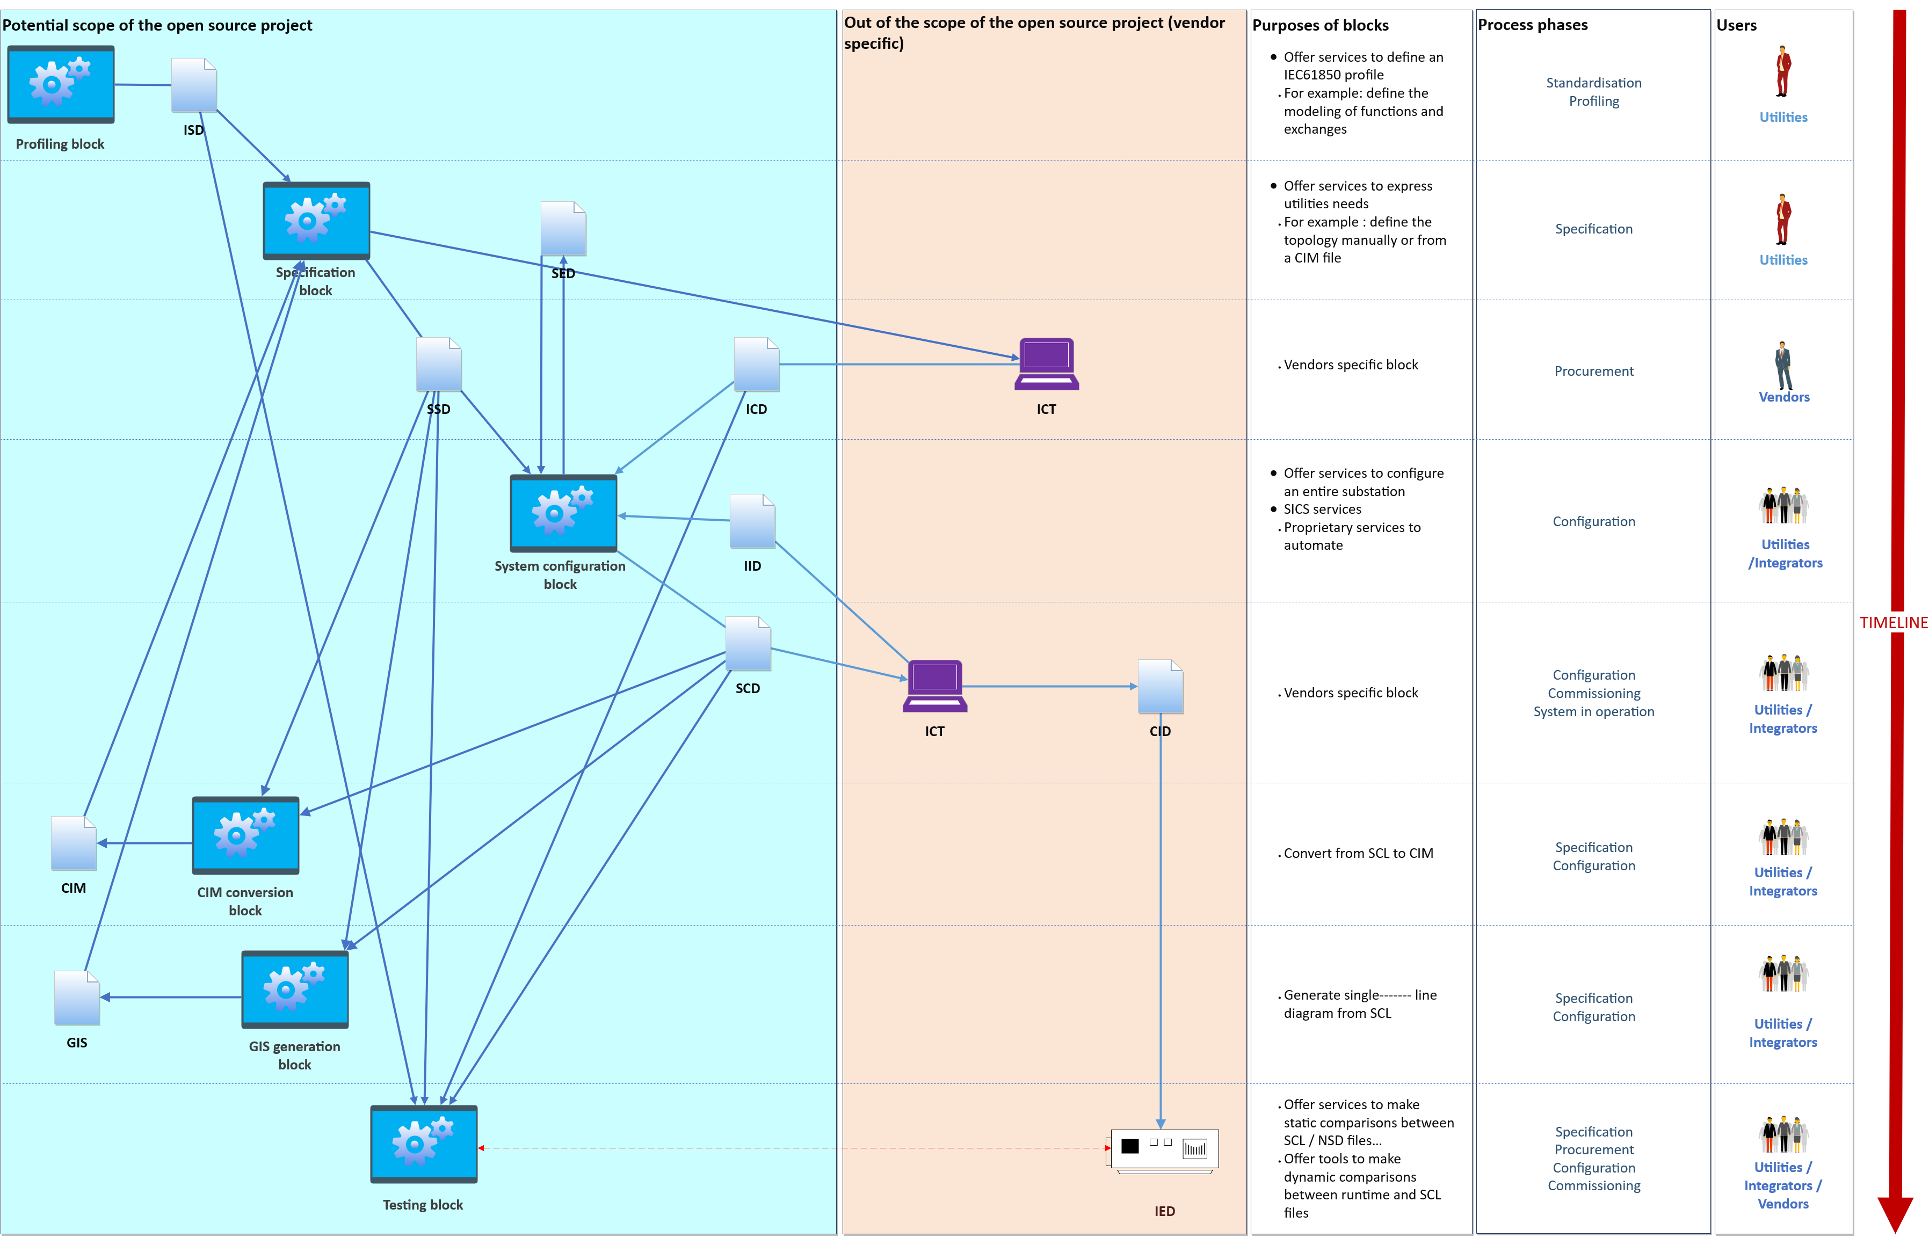
Functional diagram / building blocks

Slide 10
Principles adopted for profile management tools
The roadmap for the development of profile management tools should follow these principles:
Develop tools to facilitate profiling. The existence of an upstream profile is a key element to automatize configuration
Strictly follow the rules described in the standard fascicules
Not to develop a whole common profile
Promote shared profile implementation rules (e.g. each function is considered to be a Logical Device, acknowledge existence of functions for process interface)
Build a library of common profiles for usual functions (e.g. distance protection, gateway…)

Slide 11
System architecture and technology stack

Slide 12
Main principles for the overall architecture
The project will adopt the following principles for the overall software architecture:
A modular architecture based on microservices facilitating a tailor-made integration of the building blocks in third-party IT systems
A cross-platform software ensuring compatibility with various end-user environments.
Scriptable functional modules to enable the customization/automatization of the configuration process according to specificities of the users
Light-weight web-browser-based client
Multi-language support for the user interface

Slide 13








Architecture overview
Principles
Microservices (Docker)
Cross-platform (Docker on Windows, LINUX)
Scriptable
Database
Light-weight web-browser-based client
Multi-language support for the user interface
One programming language by microservice
Likely to integrate third-part tools (such as vendor IED tool through API, specific microservices)
User web browser HMI
Scope of the open source project
Scripting microservice to orchestrate functional microservices
Microservices for
Profiling Block
System Specification Block
System Configuration Tool
Testing Block
CIM Conversion Block
GIS Generation Block
Specific microservices or tools through API
(e.g. multiple vendor IED Configuration tools)
Database
Notes:
Open questions (to be answered after the launch of the project):
Database or file-based storage?
For a file based approach: GIT could be a base to do versioning, traceability, etc.
Programming languages? Development frameworks?
Authentication? Single sign on?
Authorization / User roles & rights?

Slide 14
Conceptual overview of the data architecture repositories and semantics
The following repositories could be defined:
ICD repository
SED repository
Template repository
Script repository
CIM semantics
IID
repository
61850 SCL semantics
Grid model repository (e.g. Powsybl)
(CGMES DL+EQ)
SLD repository
SCD++ repository
CID repository
Information flow
Notes:
Open questions (to be answered after the launch of the project):
What do we want to identify? Configuration/IED/LN/specific settings etc.? How do we want to identify this?
Internally identification (in de project) could differ form the external identification (output).
How do we want to refer to ICD's? /SED’s?
https://www.w3.org/TR/2013/NOTE-prov-primer-20130430/ ?
Do the SCD++/CID needs to be reproduceable by the scripts?
If the software can reproduce them, it might not needed to store SCD++ and CID configurations. This requires to store al aspects of the generation process.

Slide 15
Process and priorities to reach a Minimum Viable Product

Slide 16
Code development process for the project
Project’s Reference Architecture
(functional, technical, data)
Global Roadmap
Our current work
Story mapping
For each block (according to priorities), define a story mapping (personae, user-journey, story map identifying MVP and potential target). For each user story in MVP, more precise description
Code
For each users story, service and HMI code development
Users
Feedbacks

Slide 17
Priorities at the launch of the project for the development of a Minimum Viable Product
Functional block / workstream | Priority rank | Comment
Reference architecture | 1 | Confirmed as priority for MVP
System Configuration | 1 | Confirmed as priority for MVP
Testing | 2 | Pending commitment of resources (assumed to happen Q3 2020)
IEC61850-CIM mapping | 2 | Pending commitment of resources (assumed to happen Q3 2020)
System specification | 3
Profiling | 3

